Slide 1
Book Bidding App
Minal Bhavnani
Rishika Sinha
Thushanth Bengre

Slide 2
Problem Statement
Currently, there is a dearth of applications that allows readers, authors, publishers and sellers to interact with one another on a common platform.
It is not easy for readers to reach out to authors to give feedback or to contact fellow readers who are interested in the same genres as them.
Libraries across the world are also dealing with depleting resources as very few individuals or organizations volunteer to donate books.

Slide 3
Purpose
Our application aims at:
Enabling readers to maintain a virtual bookshelf
Allowing readers to follow fellow readers and contact authors
Enabling publishers to bid for a space on the reader’s screen and advertise their upcoming releases
Enabling sellers to bid for a space on the reader’s screen and advertise special offers on books
Allowing library managers to contact readers in their areas and request them to donate books

Slide 4
Social Responsibility
Our application aims at replenishing the depleting resources of public and private libraries.
It allows readers to donate books that they no longer require to a library in their area.

Slide 5
Use Cases
Reader:
Connect with Author
Follow other readers
Donate books
Add book request
Author:
Connect with readers
Library Manager:
Request for book donation
Campaign manager:
Create campaigns
Bid for advertisement space

Slide 6
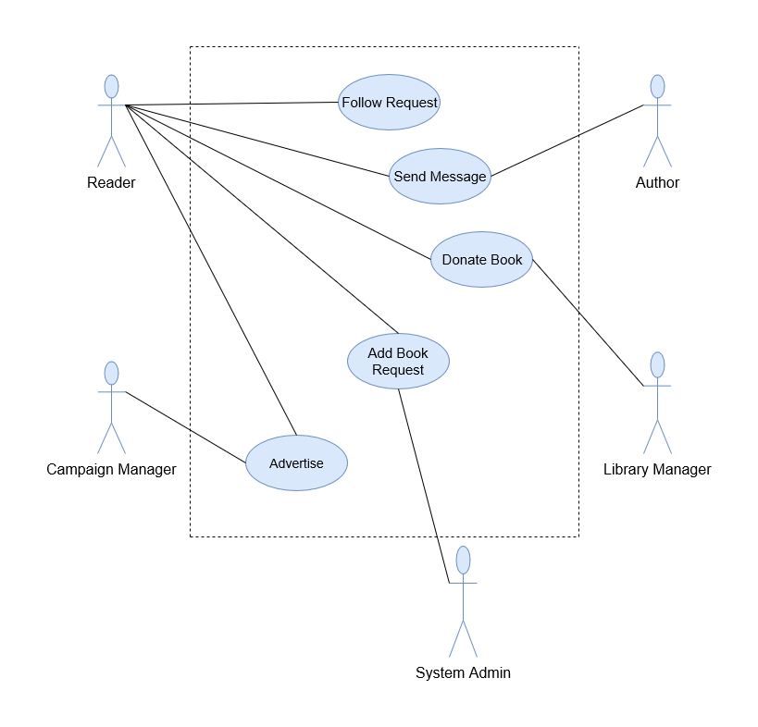
Use-Case Diagram

Slide 7
Object Model

Slide 8
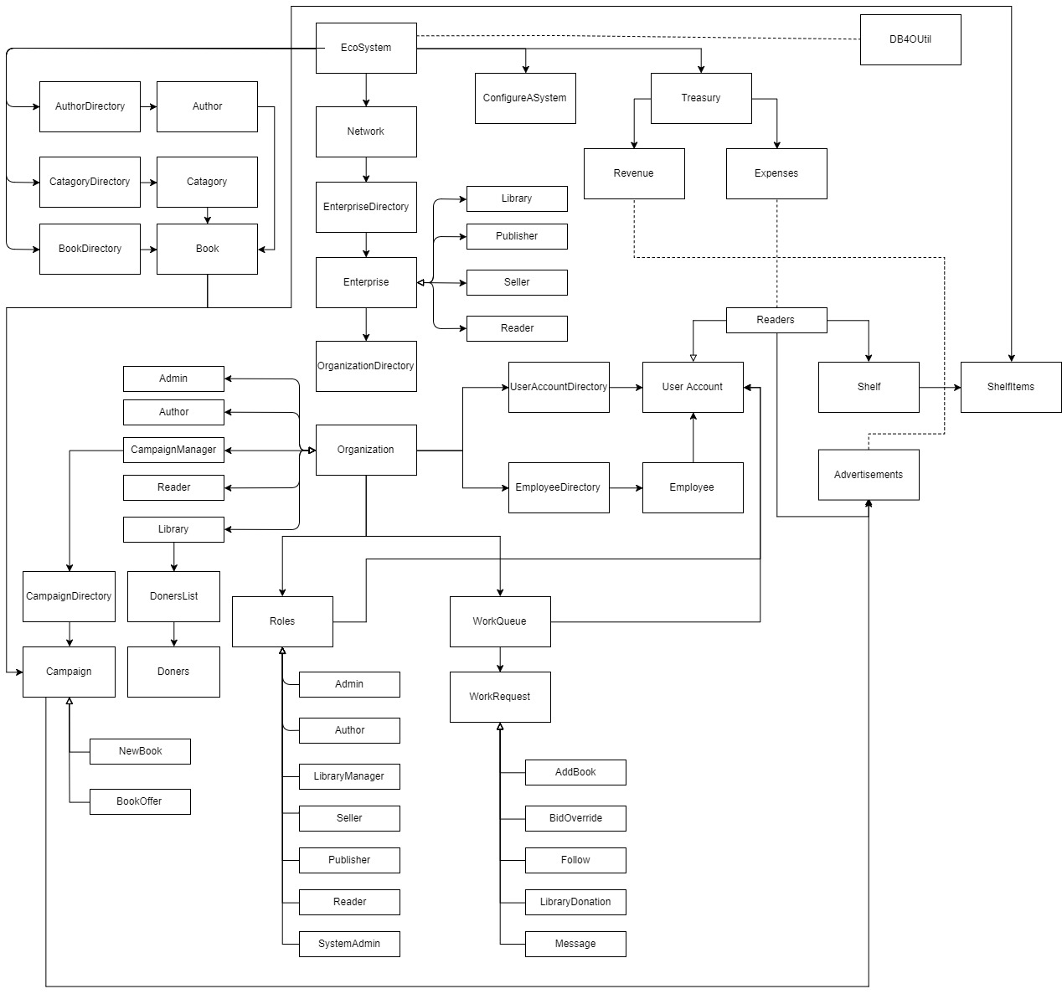

Slide 9
Demo

Slide 10
Thank You

